Slide 1
Elections Dashboard How to

Slide 2
Software needed
Anaconda to run the python script
https://www.anaconda.com/products/individual
Microsoft Excel
Power BI

Slide 3
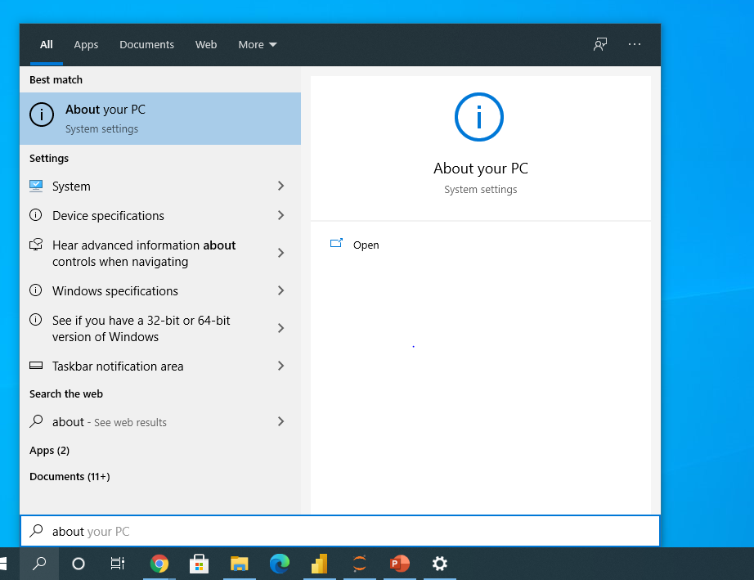
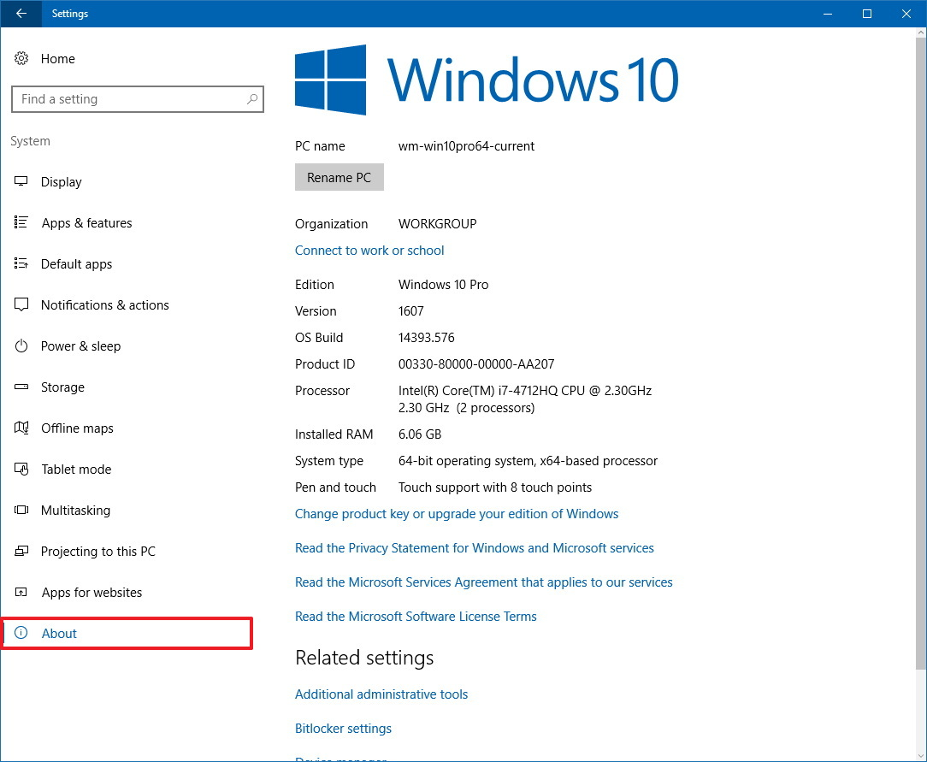
Downloading Anaconda
Determine what version of Windows you are running if downloading on a PC by searching in the Windows search bar

Slide 4
Downloading AnACONDA
Download Anaconda using the default setting
https://www.anaconda.com/products/individual

Slide 5
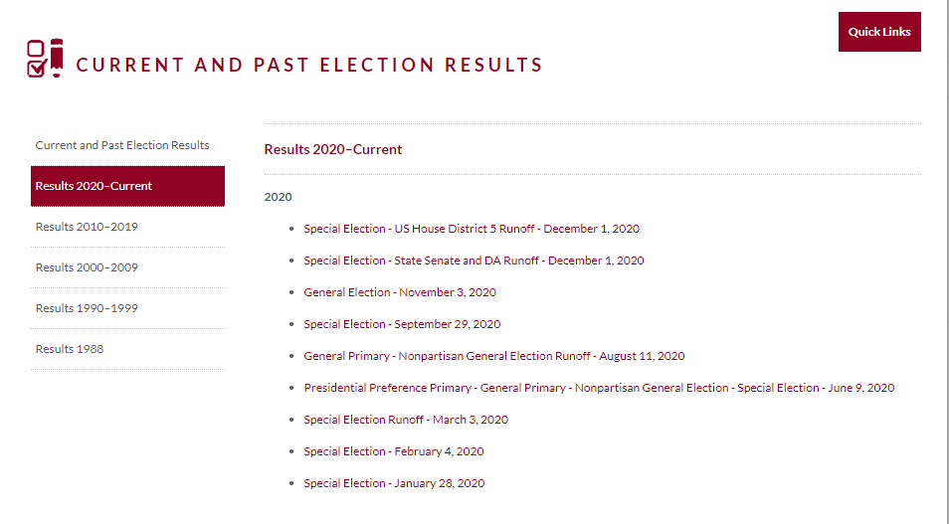
Getting the Data from the SOS website
https://sos.ga.gov/index.php/Elections/current_and_past_elections_results
Select the election cycle you want to view

Slide 6
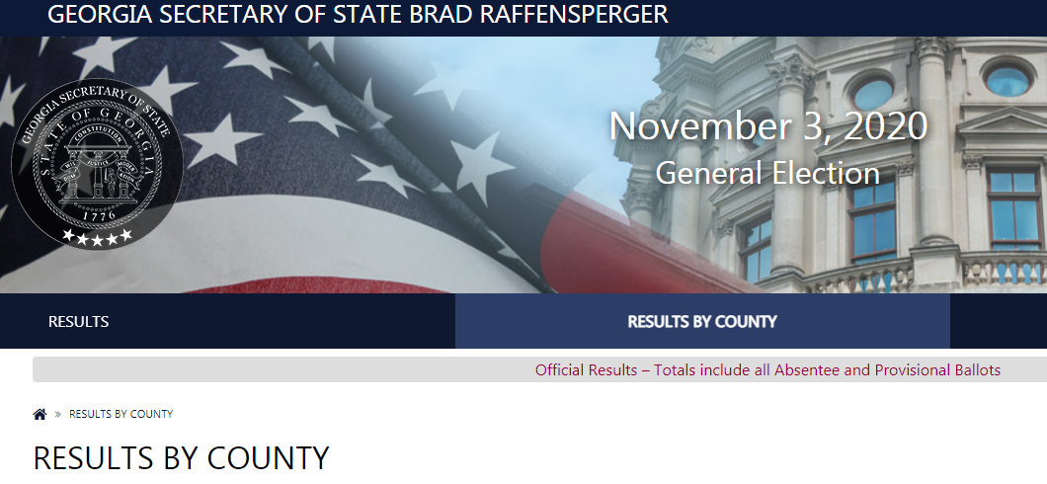
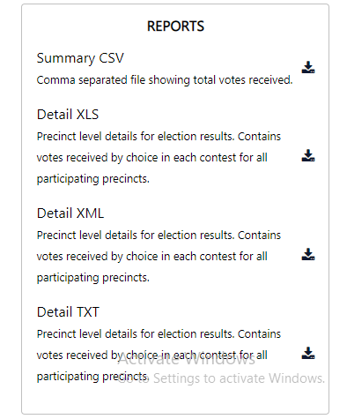
Getting the Data from the SOS website
Click on RESULTS BY COUNTY
Scroll down and select the county we will be working with which is Clarke County
Scroll down and on the right side click on the download button for the Detail XLS report.

Slide 7
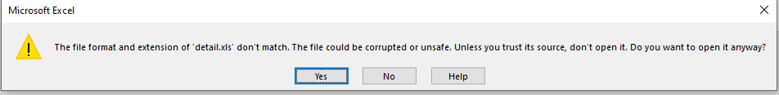
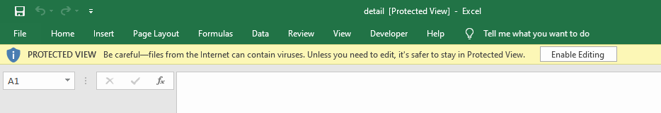
Getting the Data from the SOS website
You should get a zipped folder named detail.
Unzip the file and open up the excel file
Click Yes to the prompt and click the enable editing button on the top of the screen

Slide 8
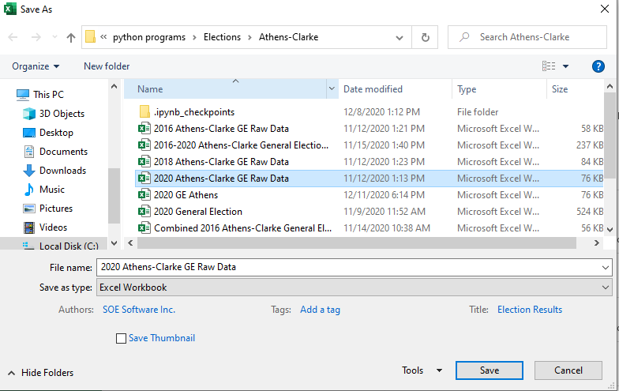
Getting the Data from the SOS website
The excel file is in the old version of excel 1997-2003. We want to say it as current version of xlsx.
Go to File > Save As
Select the Save as type to Excel Workbook in the drop down menu.
Name the file with year of the election as well the county name.
Create a new folder to save all your files in
Repeat this process for any other election years you would like to analyze.

Slide 9
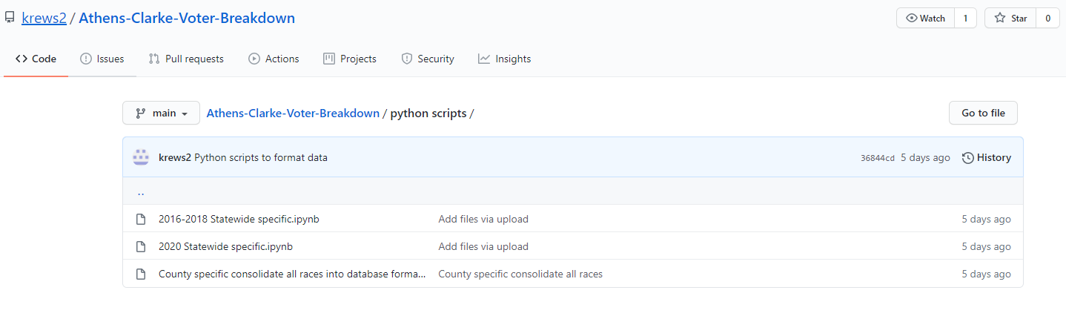
Getting the python script
The data from the SOS website is in a separate worksheet for each race that took place.
The python script will combine all the races into two worksheets with the relevant information separated between ballot questions and candidates. This will make it easier to analyze the data.

Slide 10
Getting the python script
You can download the python script from my GitHub page
https://github.com/krews2/Athens-Clarke-Voter-Breakdown/tree/main/python%20scripts
Select the County specific consolidate all races.ipynb file > Click on Raw > Right click for Save As > Erase and retype the extension .ipynb > Save in the folder with other files you have downloaded.

Slide 11

Running the python Script
After you have successfully downloaded Anaconda, you can launch a program called Jupyter Notebook (Anaconda 3) by searching for it.
A web browser should open up with the all files and folders on your computer. Locate where you saved the python script and open it.
Click on the button and the red button
You now have to enter the input filename, the election year, and what you want to name the file in small rectangle input boxes. Press enter after you enter in each value. The next slide will demonstrate the process.

Slide 12
Running the Python Script

Slide 13
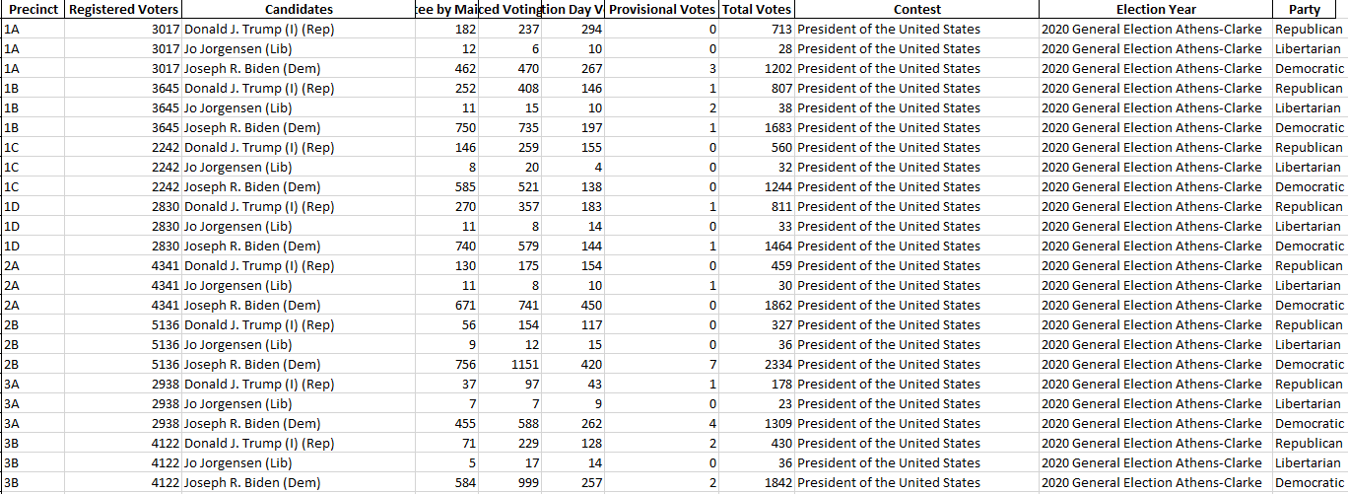
Cleaning the data
An excel file should be saved with name you entered in.
The election year column should be the value that you entered in.
There should be two worksheets one for candidates results and one for ballot results.
Double check the Party column as some of the values for the candidates do not have the party listed or the candidate is running in a smaller party.
The information has to be extracted from what is next to the candidates since the SOS data doesn’t have a separate column for the candidate’s party.
Repeat the process for the other election cycles

Slide 14
Getting the Precinct Shapefile Map
Athens-Clarke County precinct map is freely available. Other counties are not always free of charge.
https://data-athensclarke.opendata.arcgis.com/datasets/d828a7fdb4c04d63884d75e63b28d4ae_0
Click on the download button from the link above and select the Shapefile option in the drop down menu.
It should download a zipped file called ACC_Voting_Districts-shp
We will convert the shapefile into a Topojson file since that format is needed for Power BI in the next few slides. Note this step has already been completed and uploaded to my Github page, but I will walk you through the process for your reference.
https://raw.githubusercontent.com/krews2/Athens-Clarke-Voter-Breakdown/main/ACC_Voting_Districts.json

Slide 15
Converting Shapefile into TOPOJSON File
Go to mapshaper.org
Click the select button to import a folder. Simply select the ACC_Voting_Districts-shp file you downloaded previously and click import.
A map of the voting precinct in Athens-Clarke should appear on the screen.
Click on export in the top right corner of the screen and select the TopoJSON option in the Export menu and click export. Also download a CSV file so we can make sure to match precinct names from the precinct map to the SOS data we formatted.
Due to how Power BI reads in files for the map we are creating you would need to upload the TopoJSON to GitHub and get the raw format link. I have already done this step for Athens-Clarke county and have a link for a Georgia county wide map.
Athens https://raw.githubusercontent.com/krews2/Athens-Clarke-Voter-Breakdown/main/ACC_Voting_Districts.json
Georgia county map https://raw.githubusercontent.com/deldersveld/topojson/master/countries/us-states/GA-13-georgia-counties.json

Slide 16
Cleaning the data
First combine all the election cycles spreadsheets into one workbook.
Rename the sheet to reflect the election year before doing so.
Please see the gif on the right
After creating a new workbook you can add subsequent worksheets into the workbook you have created.
Delete Column A as this a index column that is not needed
Now we will make sure the precinct name on the SOS data we formatted matches the values in the TopoJSON file.
Remember we downloaded a CSV file for the voting precincts using mapshaper.org. That will used to compare to the other information.
File Save As and name the workbook 2016-2020 Athens-Clarke General Election Results

Slide 17
Cleaning the data
In the 2016-2020 Athens-Clarke General Election Results we just created in the previous slide select all the worksheet tabs by holding the Shift and individually clicking each sheet.
Insert a column before the Precinct column. Type this formula into cell B2: =Left(B2,2) autofill the formula down the column.
Copy paste values on Column B.
Name Column B in cell B1 as Precinct Code
Rename Column C in cell C1 as Precinct Name
The 2020 precincts location names can be found at link below.
https://www.accgov.com/246/Polling-Locations
You can copy and paste the information from the link above to do a VLOOKUP to match the precinct with the precinct code.

Slide 18
Adding formulas to the data
In the 2016-2020 Athens-Clarke General Election Results select all the worksheet tabs by holding down Shift and clicking each worksheet tab on the bottom.
In the blank column next to the Party column starting on row 2 copy this formula in and autofill down =COUNTIFS(A:A,A2,J:J,J2,I:I,">"&I2)+1
This formula determines the position each candidate finished in the precinct
Double check to make sure the information is correct then copy paste values on that column.
The formula should correspond to the columns A:A = Precinct Code, J:J = Contest, I:I = Total Votes. If it doesn’t just adjust the formula to the correct columns and cells.
Put the column heading as Position
In the blank column next to the Position column starting on row 2 copy this formula in and then autofill down =I2/SUMIFS(I:I,A:A,A2,J:J,J2)
This formula calculates the voting percentage for each race by precinct.
Double check to make sure the information is correct then copy past values on that column.
The formula should correspond to the columns A:A = Precinct Code, J:J = Contest, I:I = Total Votes. If it doesn’t just adjust the formula to the correct columns and cells.
Put the column heading as Percentage of Vote

Slide 19
Adding formulas to the data
Now we will create a formula
In the blank column next to the Percentage of Vote column starting on row 2 copy this formula in and then autofill down: =IF(L2="Republican",N2*-1,N2)
L2 Should under the Party column, N2 should be Percentage of Vote if not adjust the formula.
Name the column POV Var and copy paste values
This will help create a spectrum range for creating a choropleth map

Slide 20
Getting Started with Power BI Desktop
Follow the instructions on how to download POWER BI in this video
https://www.youtube.com/watch?v=5Fv-I9xQkcc&ab_channel=AviSingh-PowerBIPro
Launch Power BI
Click on Get Data > Excel > Connect > Select the Workbook 2016-2020 Athens-Clarke General Election Results > Select the Worksheets and Load in the data

Slide 21
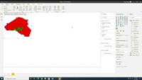
Power BI Dashboard Walkthrough

